Slide 1
The Legal Test for an EHC Needs Assessment –
Entitlement and Provision
21 March 2018
SNAP Parent Carer Forum Conference
Hayley Mason – Senior Solicitor

Slide 2
Please note:
THE MATERIAL CONTAINED IN THIS PRESENTATION IS FOR PERSONAL USE ONLY AND IS NOT TO BE RE-PRODUCED, DISTRIBUTED OR RELIED UPON

Slide 3
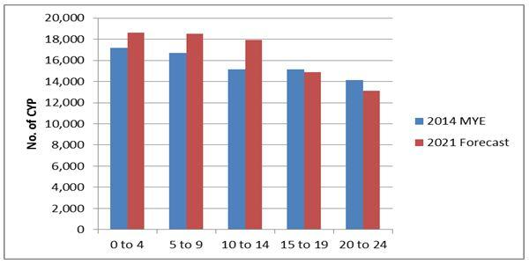
Central Bedfordshire – facts, figures and trends
The number of children and young people aged 0-24 living in Central Bedfordshire is projected to rise by 4,650 by 2021 with increases across all age groups, except 15-19 and 20-24 year olds.

Slide 4
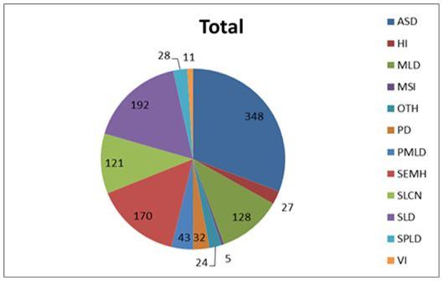
Central Bedfordshire – facts, figures and trends
In 2016, only 2.7% of pupils within all schools had a statement or EHC Plan = that equates to 1,129 children/young persons
A breakdown by special educational needs is as follows:

Slide 5
A high number of pupils are going without the correct support
– Why?
Possible explanations?
LA Officers do not read the legislation – unlikely
LA Officers seriously think that Local Authority policy overrides legislation - unlikely
Is it a budget issue? – Try it on and see if the parent will disappear? - perhaps
Parents misinformed/misadvised as to their legal rights - often

Slide 6
Surprising? Perhaps not…
www.centralbedfordshire.gov.uk has helpful guidance under their Local Offer in relation to EHC Plans.
You can click on any number of problems you may be having “I would like my child to have an EHC Needs Assessment” or “ My child does not currently have an EHC Plan” and ultimately you are referred to the “EHC Needs Assessment Pathway”.

Slide 7
The EHC Needs Assessment Pathway
25 page document to guide/advise parents.
An EHC Needs Assessment Form which is 3 pages long with an ‘evidence checklist’ – unlawful.
SEND support plan attached as an
appendix which could easily be
confused with an EHC Plan.
The Law is clear as
to what the test is,
This cannot be
Overwritten by LA
policies

Slide 8
Entitlement
There are two classes of children
those with an EHC Plan and those without.
Any parent, young person or school can request an EHC Needs Assessment under section 36(1) of the Children and Families Act 2014.
S.19 is the Local Authority’s function to involve children/young people.
Does NOT have to be the school who requests this.

Slide 9
The EHC Needs Assessment
The Application process does NOT have to be laborious.
Section 36 does not require any particular form(s) or any particular evidence.
One simple A4 page is still a valid application – too much information is sometimes detrimental.
There is no
“if we can afford it”
clause anywhere in the Code of Practice, Legislation or Case Law.
But this is different to what I have been told?

Slide 10
The Legal Test for an EHC Needs Assessment
The Legal Test has not changed.
Under S36(8) of the Children & Families Act 2014: the Local Authority must secure an EHC Needs assessment for a child/young person if the Authority is of the opinion that : -
The child or young person has or MAY have special educational needs; and
It MAY be necessary for special educational provision to be made for the child or young person in accordance with an EHC Plan.

Slide 11
What is ‘necessary’?
Unhelpful for parents but there is no set “list”
The word ‘necessary’ falls somewhere between really useful and essential. Buckinghamshire County Council v HW (SEN) [2013] UKUT 0470 (AAC)
What is ‘necessary’ is a matter to be deduced rather than defined. It’s determination will vary according to circumstances of the particular case and may well involve a considerable degree of judgement. Hertfordshire County Council v (1) MC & (2) KC SEN [2016] UKUT 385 (AAC)
It does mean all requests must be considered.

Slide 12
Further examples of misinformation
“You don’t need an EHC Plan for that, that is Social Care”.
Special Educational Provision has been redefined.
“Healthcare provision or social care provision which educated or trains a child or young person is to be treated as special educational provision (instead of healthcare provision or social care provision)”.
Section 21(5) of The Children and Families Act 2014.

Slide 13
What about high-functioning Autism children
who are not visibly failing?
Para 6.23 Code of Practice
“It should not be assumed that attainment in line with chronological age means that there is no learning difficulty or disability. Some learning difficulties occur across a range of cognitive ability and left unaddressed may lead to frustration, which may manifest itself as disaffection, emotional or behavioural difficulties”.
Hertfordshire County Council v (1) MC & (2) KC SEN 2016 UKUT 385 (AAC).

Slide 14
A true classic…
We don’t provide EHC Plans for specific learning difficulties i.e. Dyslexia
Many students with Dyslexia/Dyscalculia do have an EHC Plan
Addressed at annual conference.
Updated on BDA website.

Slide 15
But the system is reliant on parents applying…
All parents who want to end up with an EHC Plan, the first step is the request for an EHC Needs Assessment.
If you cannot get past this hurdle, you cannot
get an EHC Plan.

Slide 16
Timescales
Once parents have requested an EHC Needs Assessment
The LA have 6 weeks to make a decision (if answer is no – Parental Appeal to the SEND Tribunal).
At 16 weeks the LA must make decision whether to issue EHC Plan or not (if answer is no – Parental Appeal to the SEND Tribunal).
The LA must issue a Draft Plan at 18 weeks - Parent has 15 days for comment.
Finalisation of EHC Plan is 20 weeks from the EHC Needs Assessment request (if unhappy with content – Parental Appeal).
These deadlines should not be extended. If the LA miss a deadline this is easily resolved by a simple Pre-Action letter.

Slide 17
EHC Needs Assessment Process
The list of assessments which should be undertaken for a new EHCP
(Regulation 6 of The Special Educational Needs & Disability Regulations 2014 No1330)
is the same as a transfer from a Statement to an EHCP
(Regulation 18 of the Children & Families Transitional & Savings Provision) (No2 Order) 2014 No 2270).

Slide 18
Who do we need advice from?
Whether you are transferring from a Statement or undergoing an EHC Needs Assessment for the first time a full EHC Needs Assessment needs to be carried out. Needs and Provision should NOT be simply “cut and pasted” from a child's Statement to EHC Plan.
Advice should be provided by:
Parent
Head/SENCO
Medical
Educational Psychological
Social Care
Hearing & visual impairment where relevant

Slide 19
The EHC Plan – When You Get It
The EHC Plan is a complex twelve section document (as section H is in 2 parts).
Section A – parent’s/child’s views
Section B – Child or young person’s Special Educational Needs
Section C - Health needs related to their SEN
Section D – Social Care needs related to their SEN
Section E – SEN outcomes
Section F – Special Educational Provision
Section G – Health provision
Section H1 – Social Care provisions resulting from Section 2 of the Chronically sick & Disabled Persons Act 1970
Section H2 – Social Care Provision reasonably required
Section I – Educational Placement
Section J – Personal Budget
Section K – Appendices and Advice/Information
The Educational sections of an EHC Plan are Sections B, F & I
B, F and I are the only sections which are legally enforceable
Right of Appeal to the SEND Tribunal

Slide 20
The EHC Plan – When You Get It
Often an empty document
Sections B, F & I have to be separately labelled. If it is not clear what is educational provision.
All sections must be specific, detailed and quantified.
Lack of specificity – compromises legal enforceability - how long or how often is “access to?” “Benefits from?”
Remember, the redefinition of Special Educational needs (Section 21(S)). This means waking day curriculums, behavioural management therapies, life skills e.g. travel training should be included in Section F and DOES NOT require part funding from health or social care (East Sussex County Council v TW [2016] UKUT 0528).
All provision in Section F has to be carried out.

Slide 21
Why should Parents Appeal to the SEND Tribunal?
Appealing to the SEND Tribunal – levels the playing field and will give parents equality with Central Bedfordshire.
How do I Appeal? – Download Appeal forms from the SEND Tribunal website, file together with your ‘Reasons for Appeal’.
Where do parents Appeal? – SENDT Darlington office
The SEND Tribunal process is the same for all SEN appeals
Refusal to undertake an EHC Needs Assessment
Refusal to issue an EHC Plan
Failure to correctly transfer a Statement to an EHC Plan
EHC Plan content (sections B,F & I)
Notification of Cease to Maintain Statement or EHC Plan

Slide 22
Thank you for listening
www.senlegal.co.uk

